Slide 1


R. N. G. Patel Institute of Technology (RNGPIT)
Computer Science and Engineering Dept.
Semester : 8th
Subject : Internship/Project (3183101)
Presentation
Backend developer intern
Prepared By:: | Faculty Mentor:: | Industry Mentor::
Pansuriya Darshil J. 180840131033 | Mr. Vivek C. Joshi Assistant Professor CSE, RNGPIT | Ms. Priyanka Rajani Team Leader Infozium Solution PVT LTD

Slide 2
Outline
Overview of Company
Introduction of the Internship Work (Purpose, Objective, Scope, Technologies, Literature review)
Timeline Chart for 12 weeks Internship
Training Work
Abstract of Project
Description of modules on which you have worked
Implementation Work
Test Cases
Problem Encountered by you and Possible Solutions
Summary of Internship
Conclusion
Limitation and Future Enhancement
References

Slide 3
Overview of Company
Infozium Solution PVT LTD which is Software Solution Base Company which is Located In Surat.
Goal of the Company is that to provide the good and reliable solution to Client. Working on Many Trending Technologies Like React Native ,Flutter, ReactJS, Node JS, PHP etc…
Company have many teams which have experts in that fields of technology and create a multiple solution with their expertise and provide it to client.
Organization have mainly three departments which is Mobile application department, web application department and game department.

Slide 4
Introduction of the Internship Work
Main Purpose of an Internship that I want to learn new technologies which are use by the companies Nowadays.
To gain real work experience and provide meaningful assistance to the company.
During internship I learned the nodejs framework which is used to develop the backend.
Worked on the Warehouse management project which is related to delivery services.

Slide 5
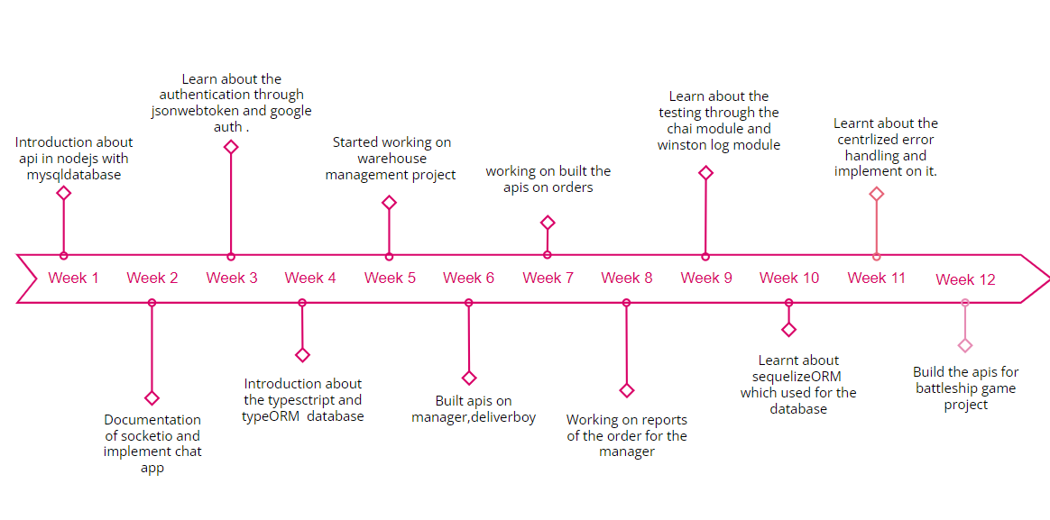
Timeline Chart for 12 weeks Internship

Slide 6
Training Work
Learnt about the Javascript’s several object methods such as assign , create , freeze and more.
Later on, Gain the knowledge of HTTP requests like GET, POST, PUT, DELETE and how the REST API Works in Nodejs.[1]
Started working on the practical implementation of rest api in nodejs and intergrating api with the mysql database.
Fetch the data from json file and insert into mysql database and create api on those data.

Slide 7
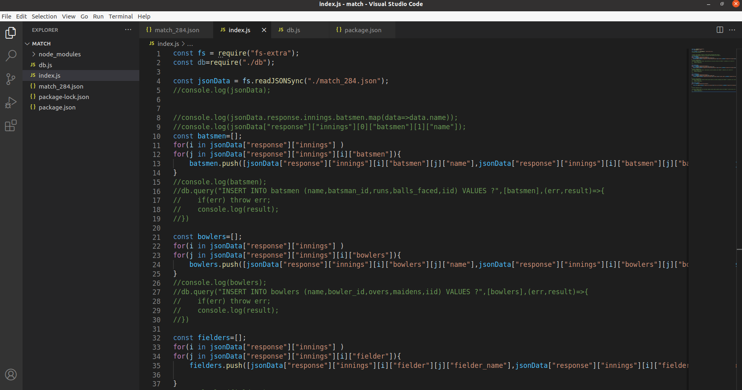
Training Work

Slide 8
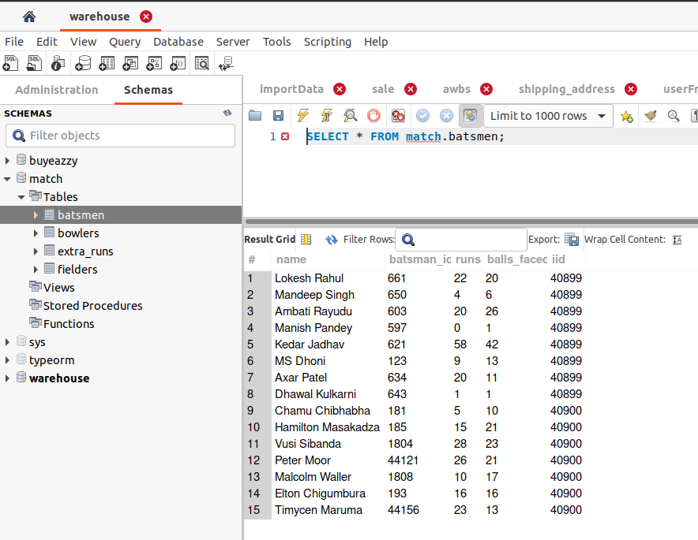
Training Work

Slide 9
Training Work
Working on the file module and validate the file uploadation in nodejs.
Learnt documentation about the socketio which is bi-directional communication between web clients and servers. It has two parts: a client-side library that runs in the browser, and a server-side library for Nodejs.
Build the simple chat app using the socketio in which users enter into rooms and chatting with each other.

Slide 10
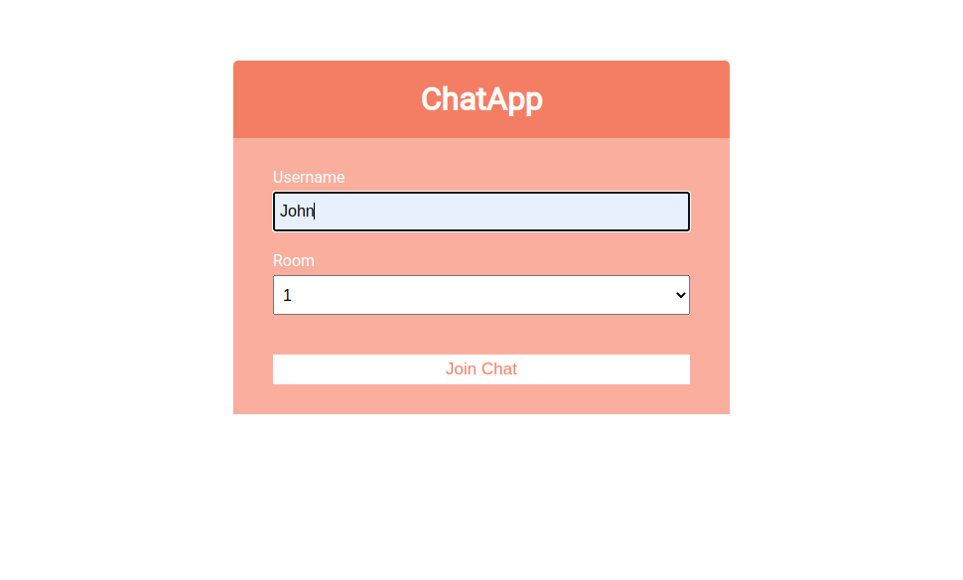
Training Work

Slide 11
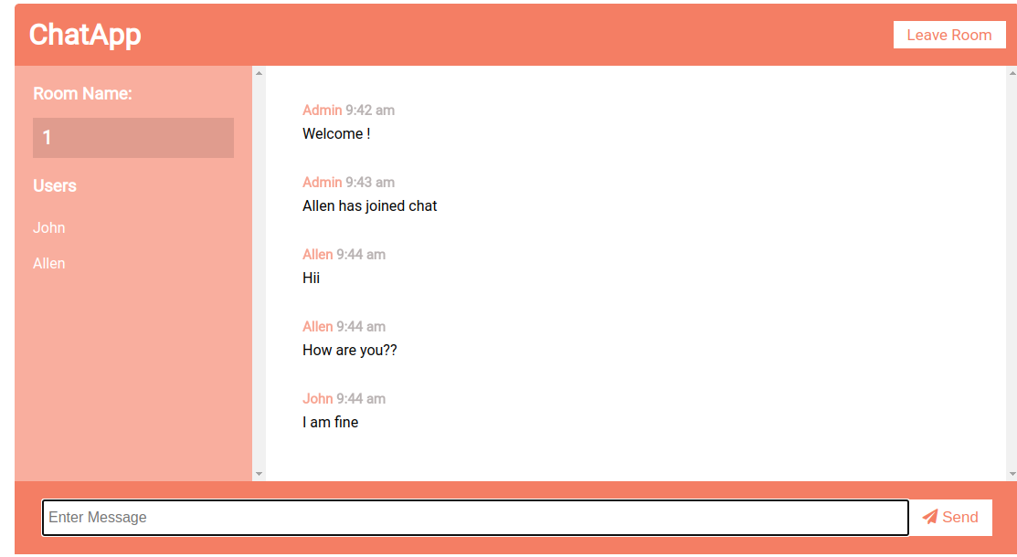
Training Work

Slide 12
Training Work
Learnt about the JsonWebToken which used for the authentication a user.
Implementation of jsonwebtoken with the accesstoken and the refreshtoken.
Implement passport-local-stratergy which is used for the authentication.
Google based authentication and facebook based authentication implement using the passport stratergy.

Slide 13
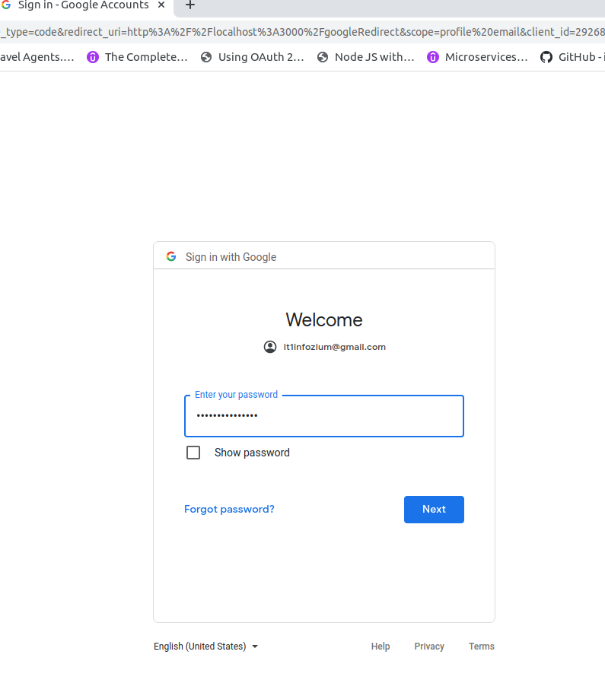
Training Work

Slide 14
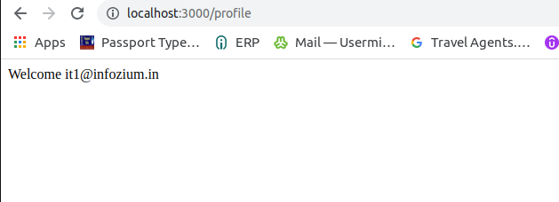
Training Work

Slide 15
Training Work
Overview of typescript, basic syntax of typescript, type annotations and inference.
Learnt about the typeORM which is Object Relational library.
In typeORM entities, embeded entities, relations one to one , many to one, one to many.
Learnt the Select , insert, update, delete Query builder which is used for the CRUD operation.
Implementation of the CRUD operation and relations between the entities.

Slide 16
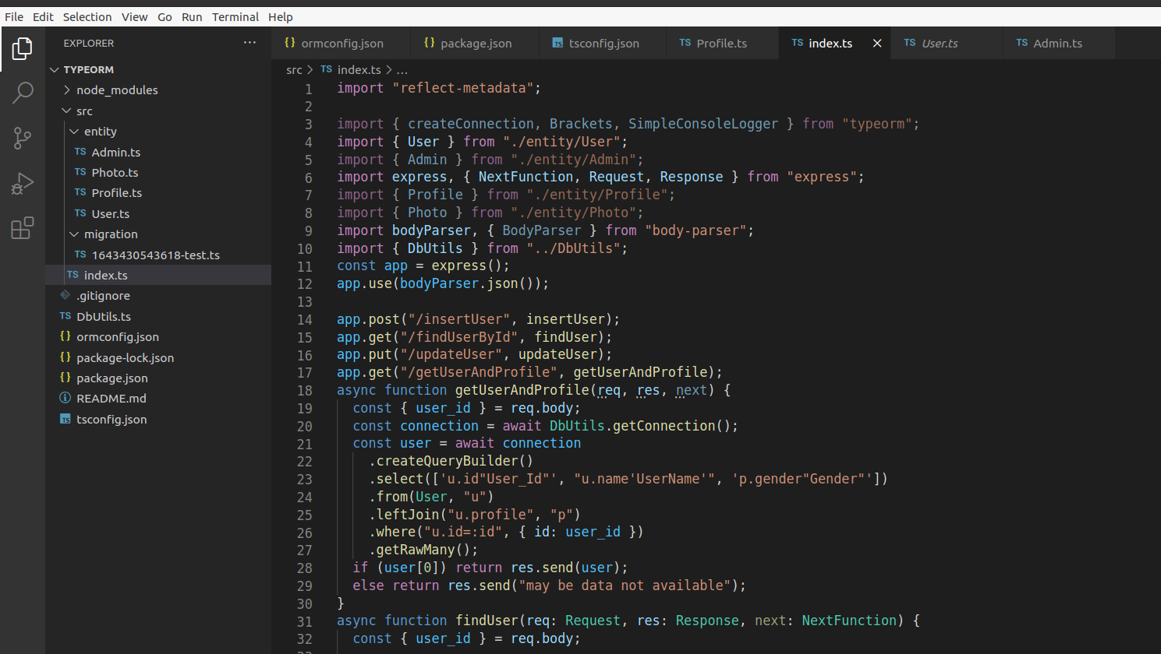
Training Work

Slide 17
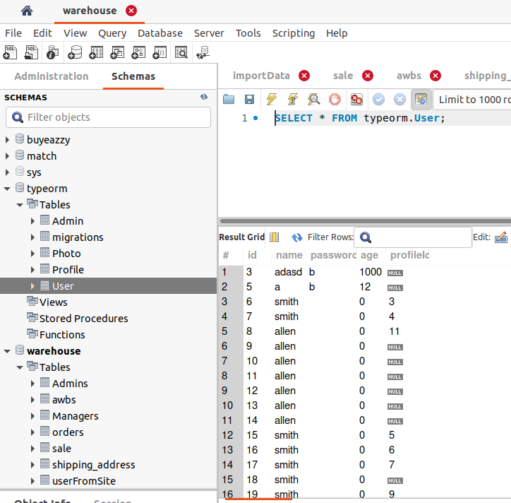
Training Work

Slide 18
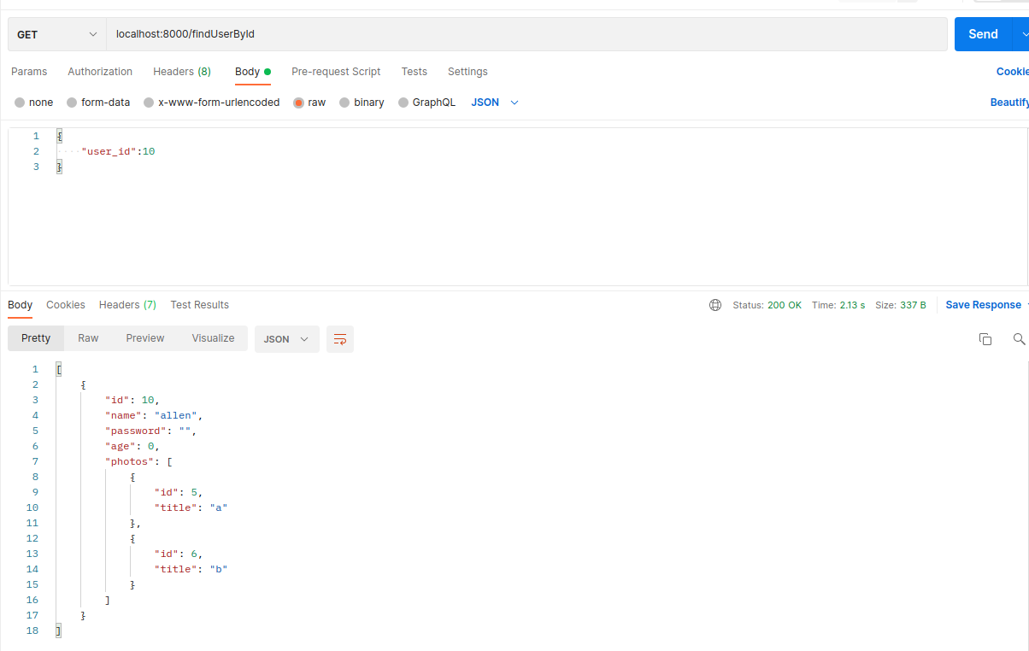
Training Work

Slide 19
Abstract of Project
Warehouse management
Warehouse Management is based upon delivery services.It has mainly three Roles are Admin, Warehouse Manager and Delivery Boy In which admin and warehouse manager uses the web app and delivery boy uses the mobile app.
Admin can add/edit/delete Warehouse Manager and Delivery Boy as well apart from that admin can view/ edit delivery boy and Warehouse Manager. Admin can Manage, view, Assign Orders to Managers and Delivery Boys.
Warehouse Manager assign order to Delivery Boy and Download status of order and Payment Collection report.
Delivery Boy view all orders and Delivered the order and update the status of order and collect the payment.

Slide 20
Description of modules
Admin Manages Warehouse Manager and Delivery Person
In this module I’ve developed APIs for Create, Edit, Block the Warehouse, Warehouse Manager, Delivery Person.
Manager can upload order and assign order
In this module I’ve developed APIs for manager can upload orders, view all orders, view assign orders, delivery type of orders, assign orders to delivery person.
Admin and Manager can view reports of orders
In this module, I’ve added APIs for manager and admin can check the status of order by particular Delivery person and the from and to Date and also download the payment collection report.

Slide 21
Implementation work
It has main three roles admin, warehouse manager and Delivery Boy.
Build the Register and Login api for the Delivery Boy and Warehouse manager which is used by the admin.
Create Delete, update, block, unblock api for the delivery boy and warehouse manager which is controlled by the Admin.

Slide 22
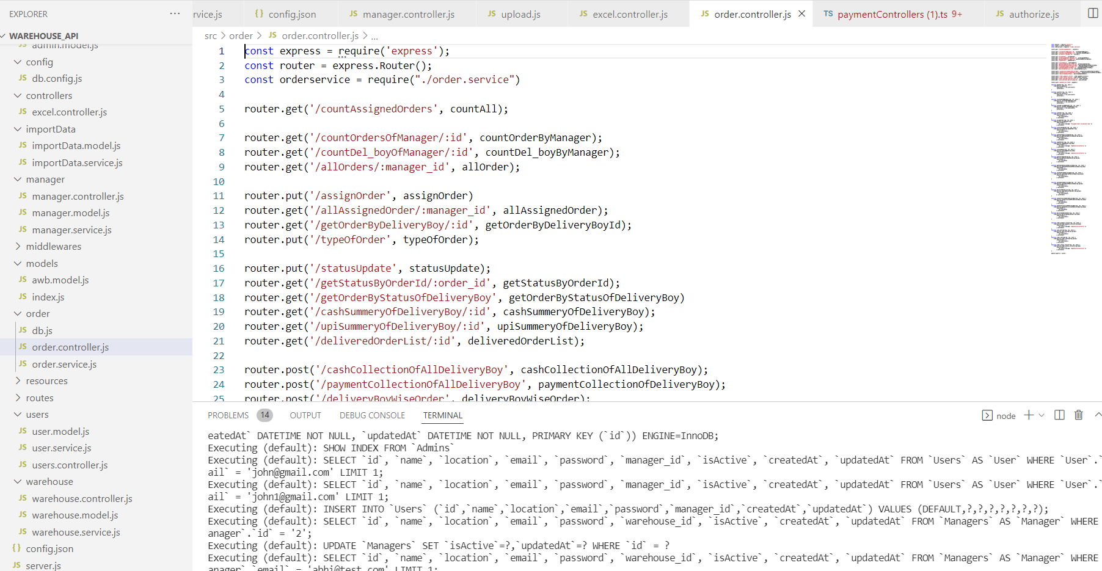
Implementation work

Slide 23
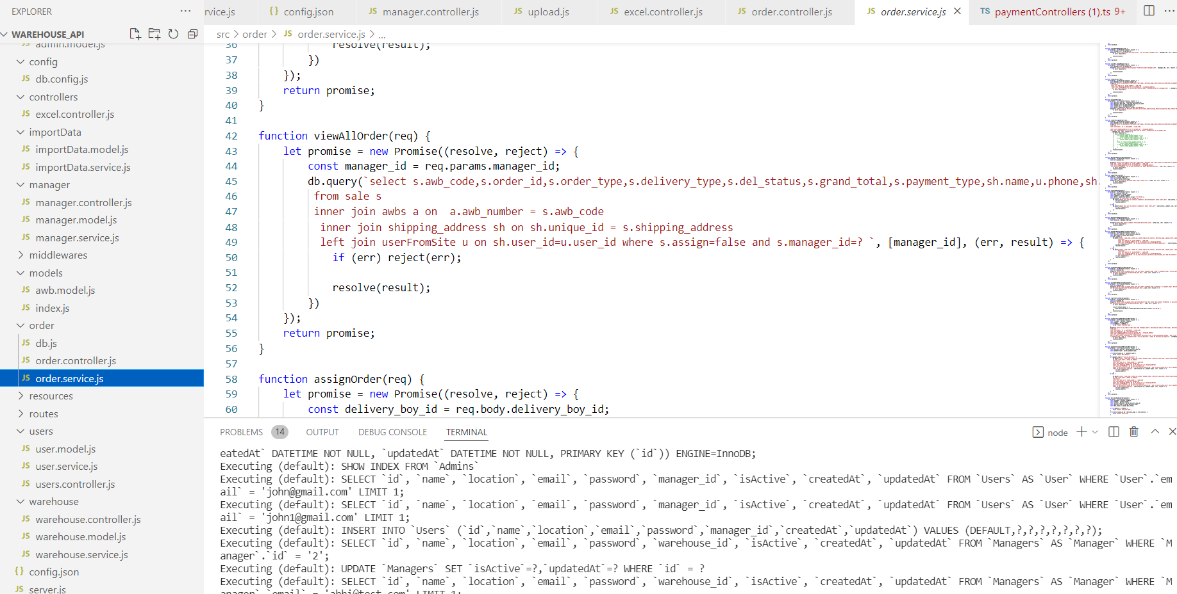
Implementation work

Slide 24
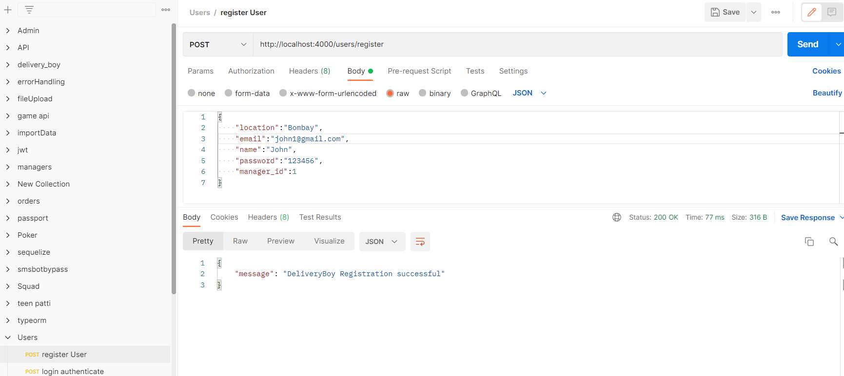
Implementation work

Slide 25
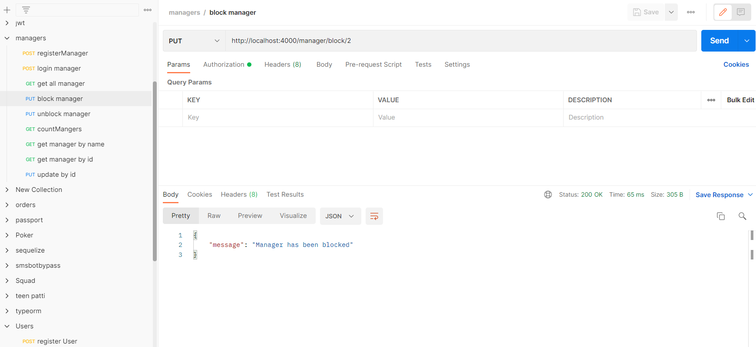
Implementation work

Slide 26
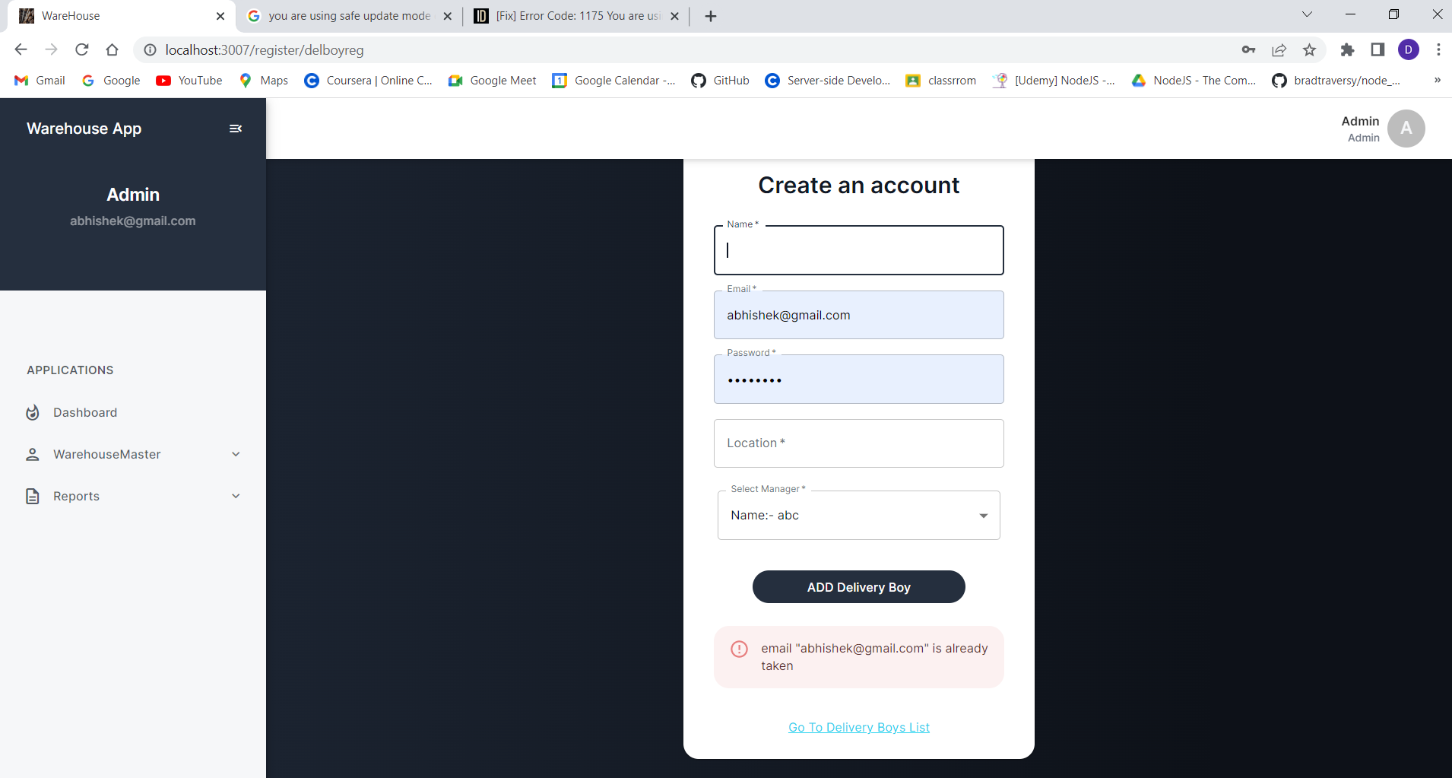
Implementation work

Slide 27
Implementation work
Build the api for upoad excel file and file data insert into the database.
Create the api for order assign by the warehouse manager to the Delivery Boy and Delivery Boy view the all assigned order.
Build api of view order between the from date and to date.

Slide 28
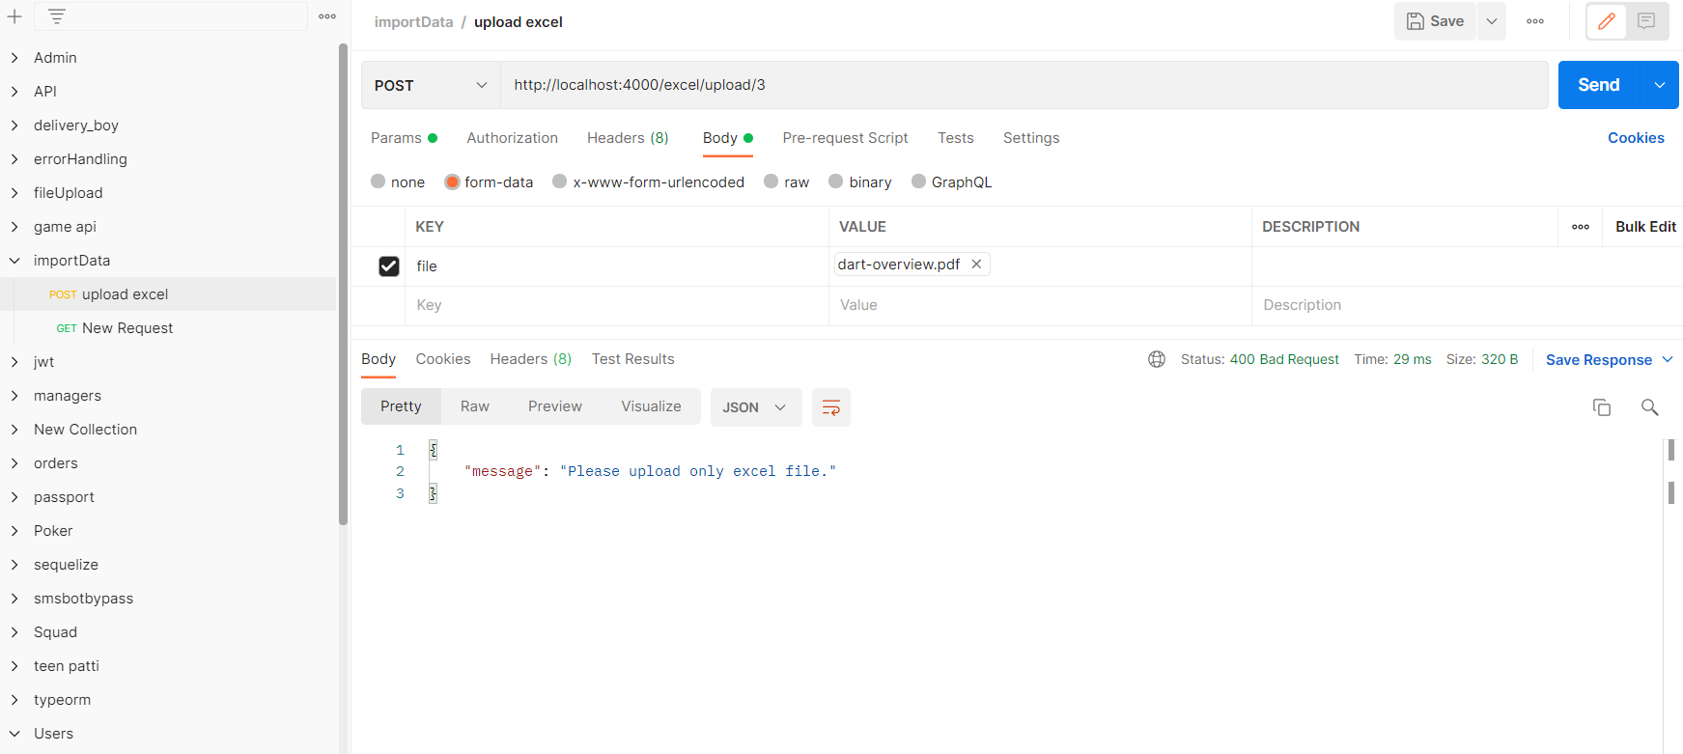
Implementation work

Slide 29
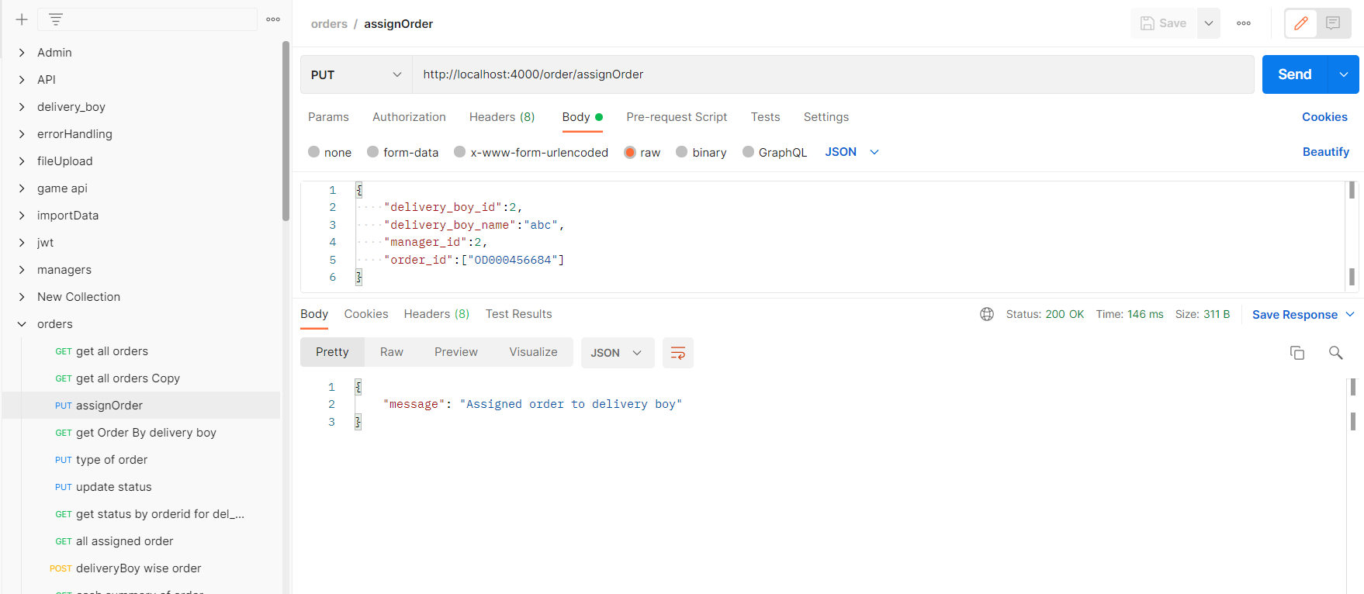
Implementation work

Slide 30
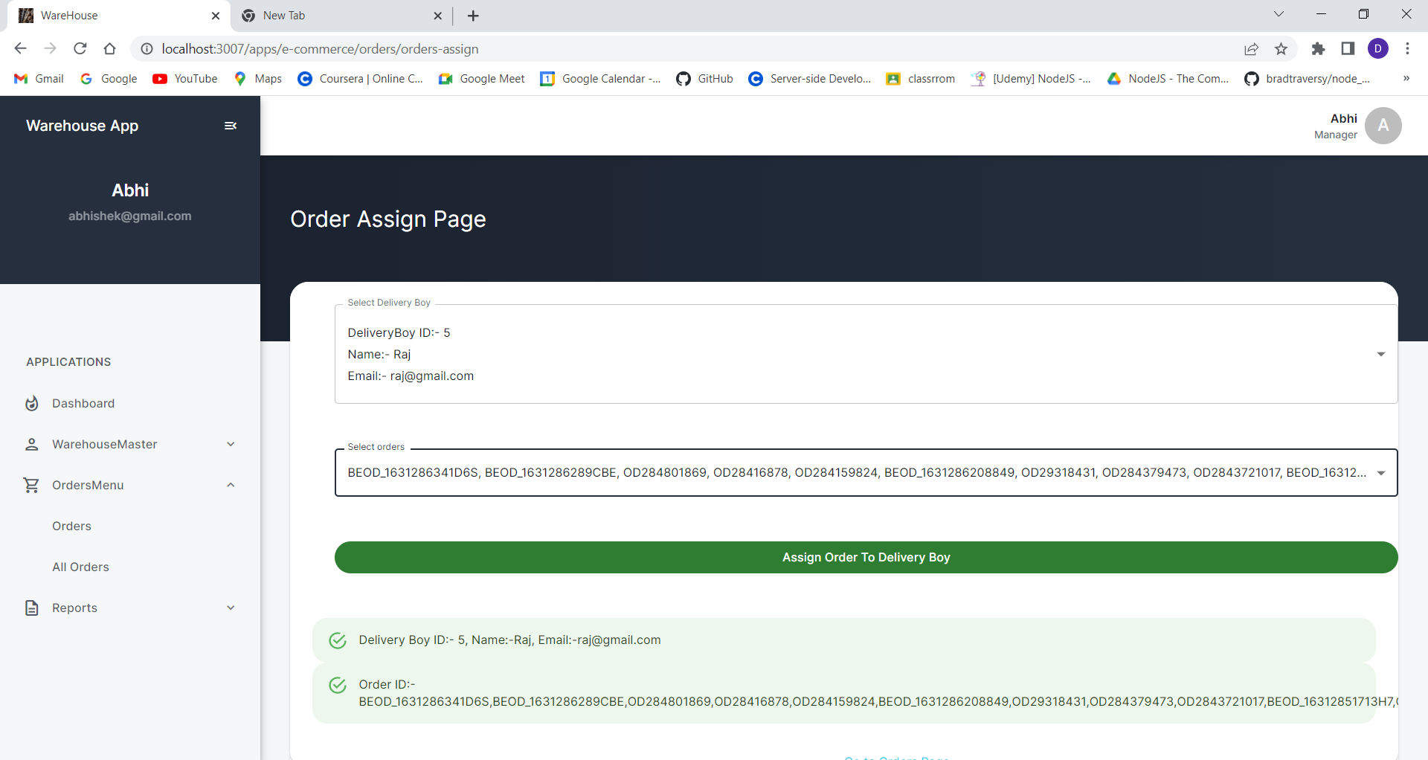
Implementation work

Slide 31
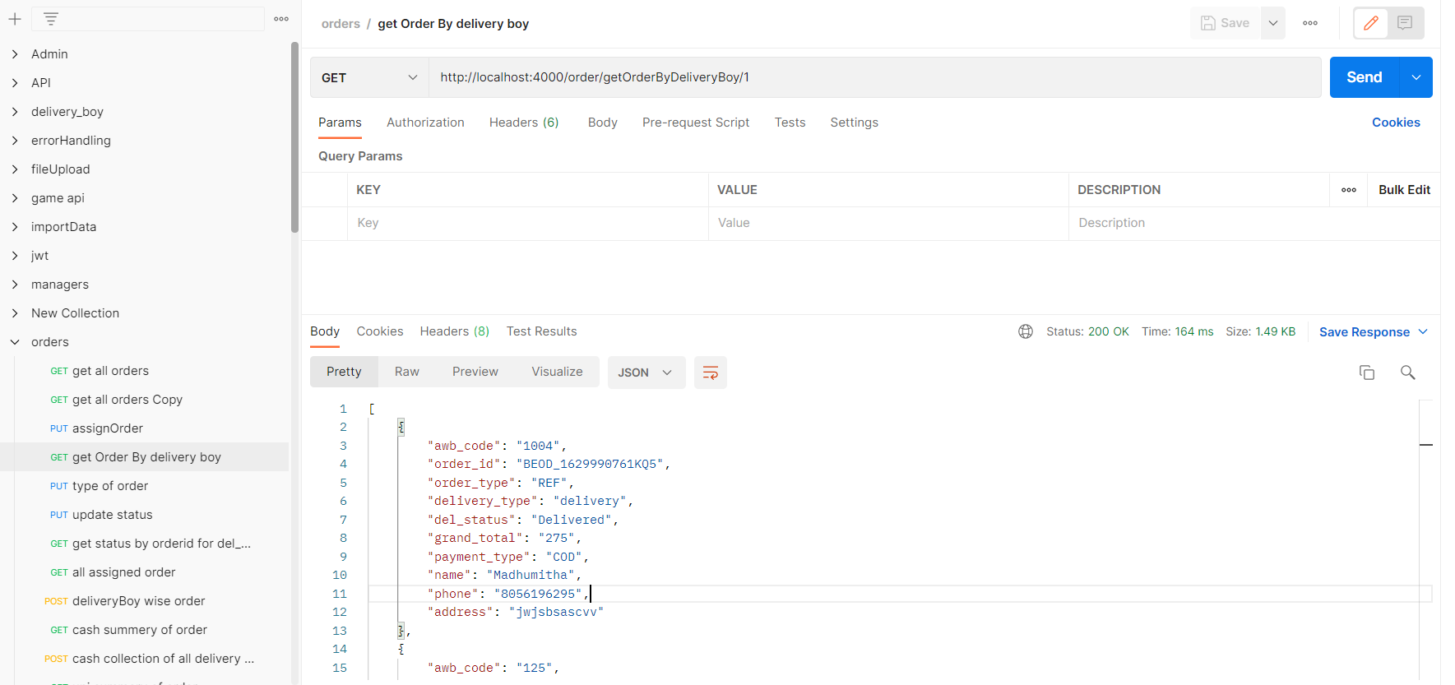
Implementation Work

Slide 32
Implementation work
Build the status update of order by delivery boy api and solved error on it.
build the view all assigned order and status of order api.
Create the delivery boy wise and datewise api and changes on it.
build the api of cash summery of delivery boy for the manager.
Working on excel sheet download of cash collection by delivery boy api.

Slide 33
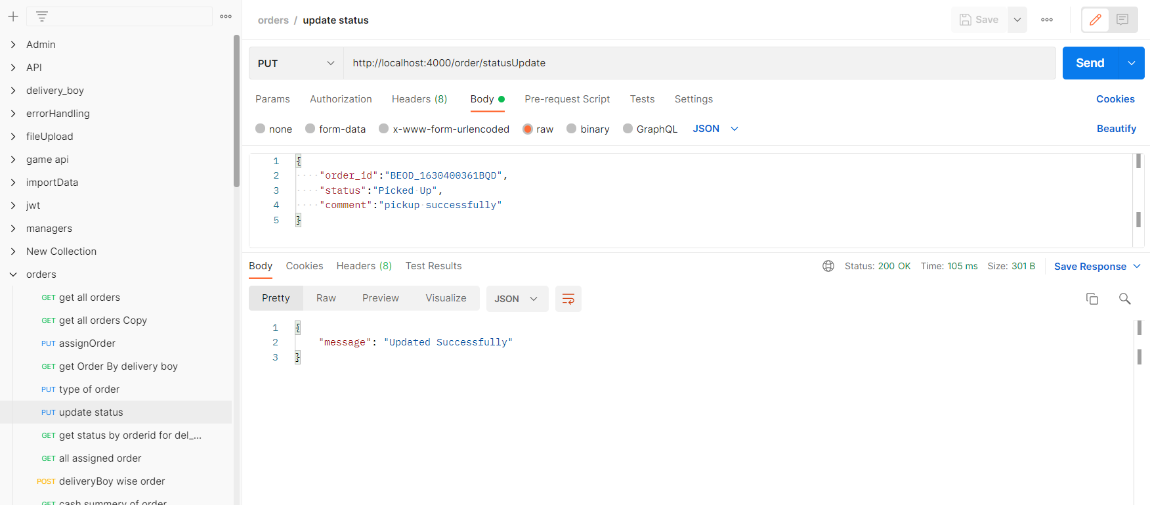
Implementation work

Slide 34
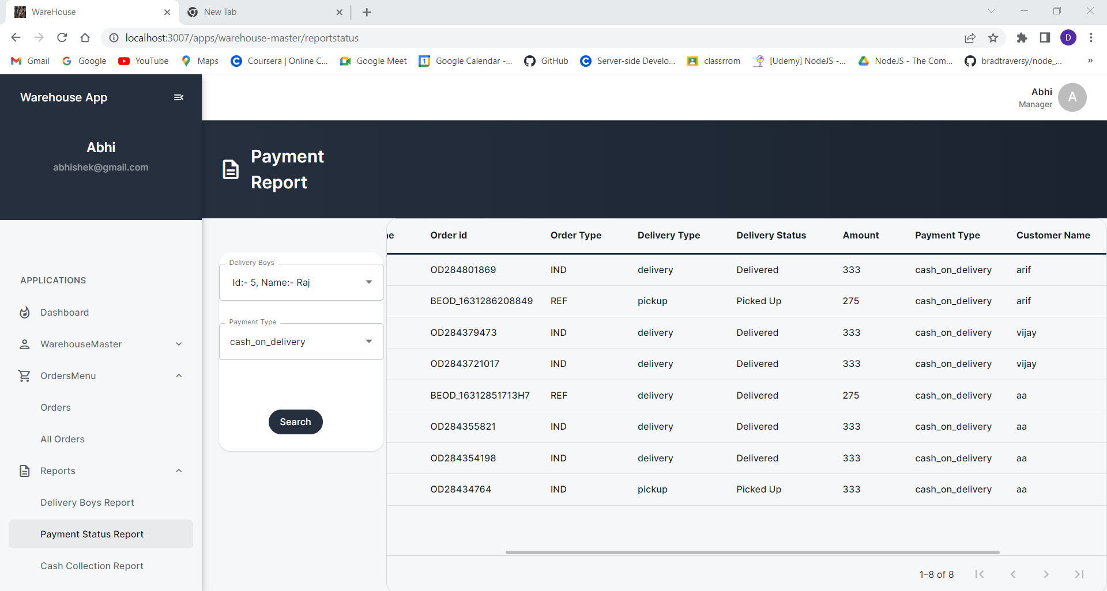
Implementation work

Slide 35
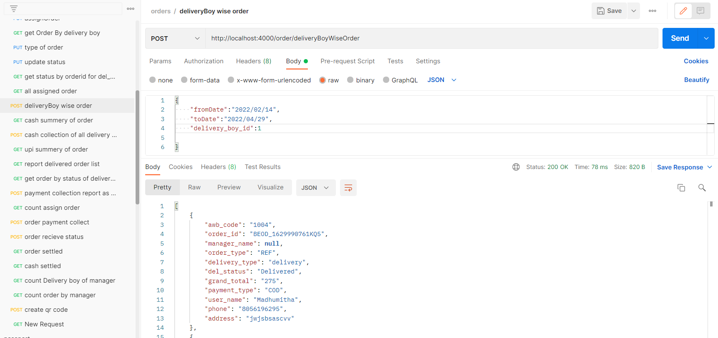
Implementation work

Slide 36
Implementation work
Build get order by the status updated by the delivery boy and report of delivered order api.
Build the api for cash collection by delivery boy for the manager .
Create the track order as per order status for the delivery boy and changes in payment collection report.

Slide 37
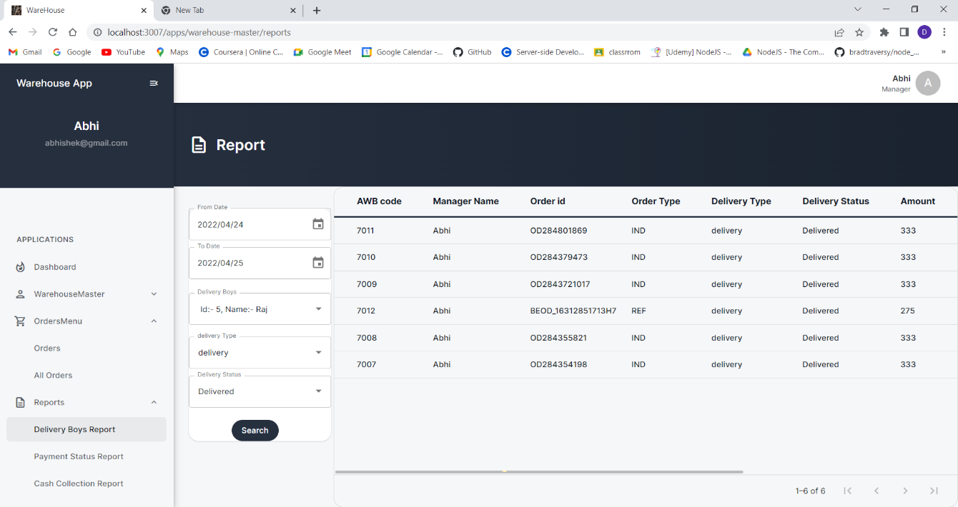
Implementation work

Slide 38
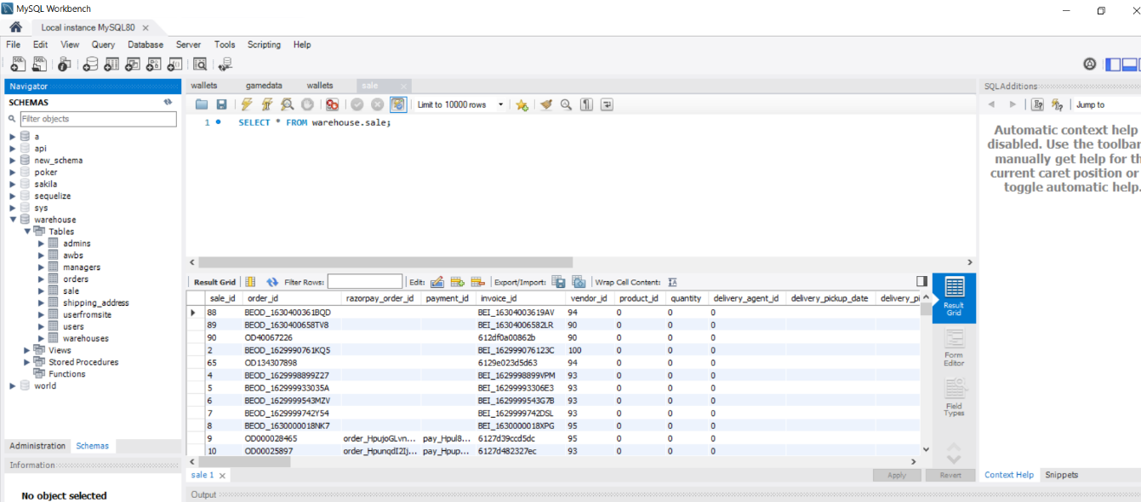
Implementation work

Slide 39
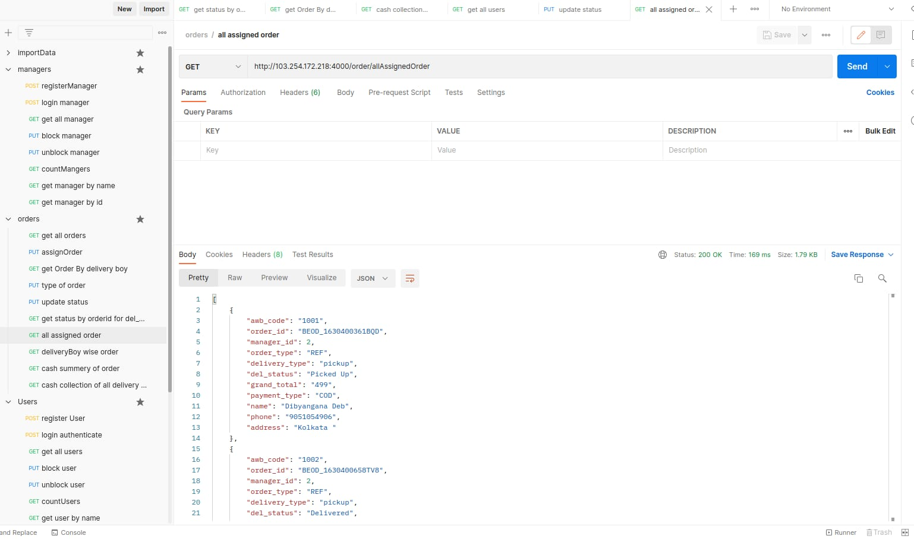
Implementation work

Slide 40
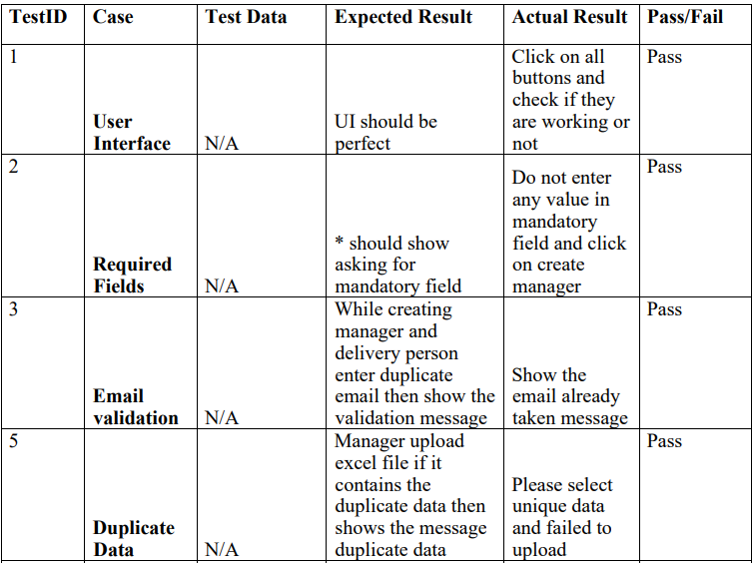
Test cases

Slide 41
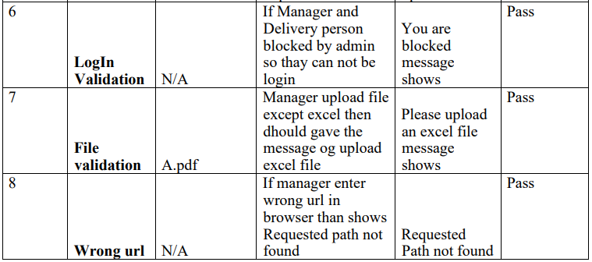
Test cases

Slide 42
Problem Encountered by you and Possible Solutions
Encountered several problems during the development of projects. some of those problems are mentioned below:
Faced difficulties while uploading the excel file and downloading excel file which contains the data.
For that problem found the exceljs and read-excel-file/node module and use of them.

Slide 43
Summery of internship
To experience the practical working of what we studied in the book theories, is very interesting, memorable and very important in our education. Doing internship is my first experience of working for any company and learn how the things are being done in the actual industry.
This internship has been an excellent and rewarding experience. During this internship I Learn about the how the projects being develop in the actual industry Also know about the company works and deals with the big clients.

Slide 44
Conclusion
During internship Learnt about the new technologies and gain the practical skills on it.

Slide 45
Limitation and Future Enhancement
Warehouse management system used for the delivery of orders of the large ecommerce application.
In Future learn about the different different socket related library which is used into the back-end development of game.

Slide 46
References
[1] NodeJS:
https://www.udemy.com/course/the-complete-nodejs-developer-course- 2/learn/lecture/13729518#overview
[Accessed: 05-Jan-2022]
[2] JWT Token Implementation:
https://www.section.io/engineering-education/how-to-build-authentication-api-with-jwt-token-in-nodejs/
[Accessed: 26-Jan-2022]
[3] Sequelize ORM:
https://sequelize.org/docs/v6/
[Accessed: 28-Jan-2022]
[4] Upload and download excel file in NodeJS:
https://www.bezkoder.com/node-js-upload-excel-file-database/
[Accessed: 10-Feb-2022]

Slide 47
THANK YOU

